Slide 1
Learning Semantic Relationships of Geographical Areas Based on Trajectories
Saim Mehmood & Manos Papagelis
IEEE MDM 2020

Slide 2
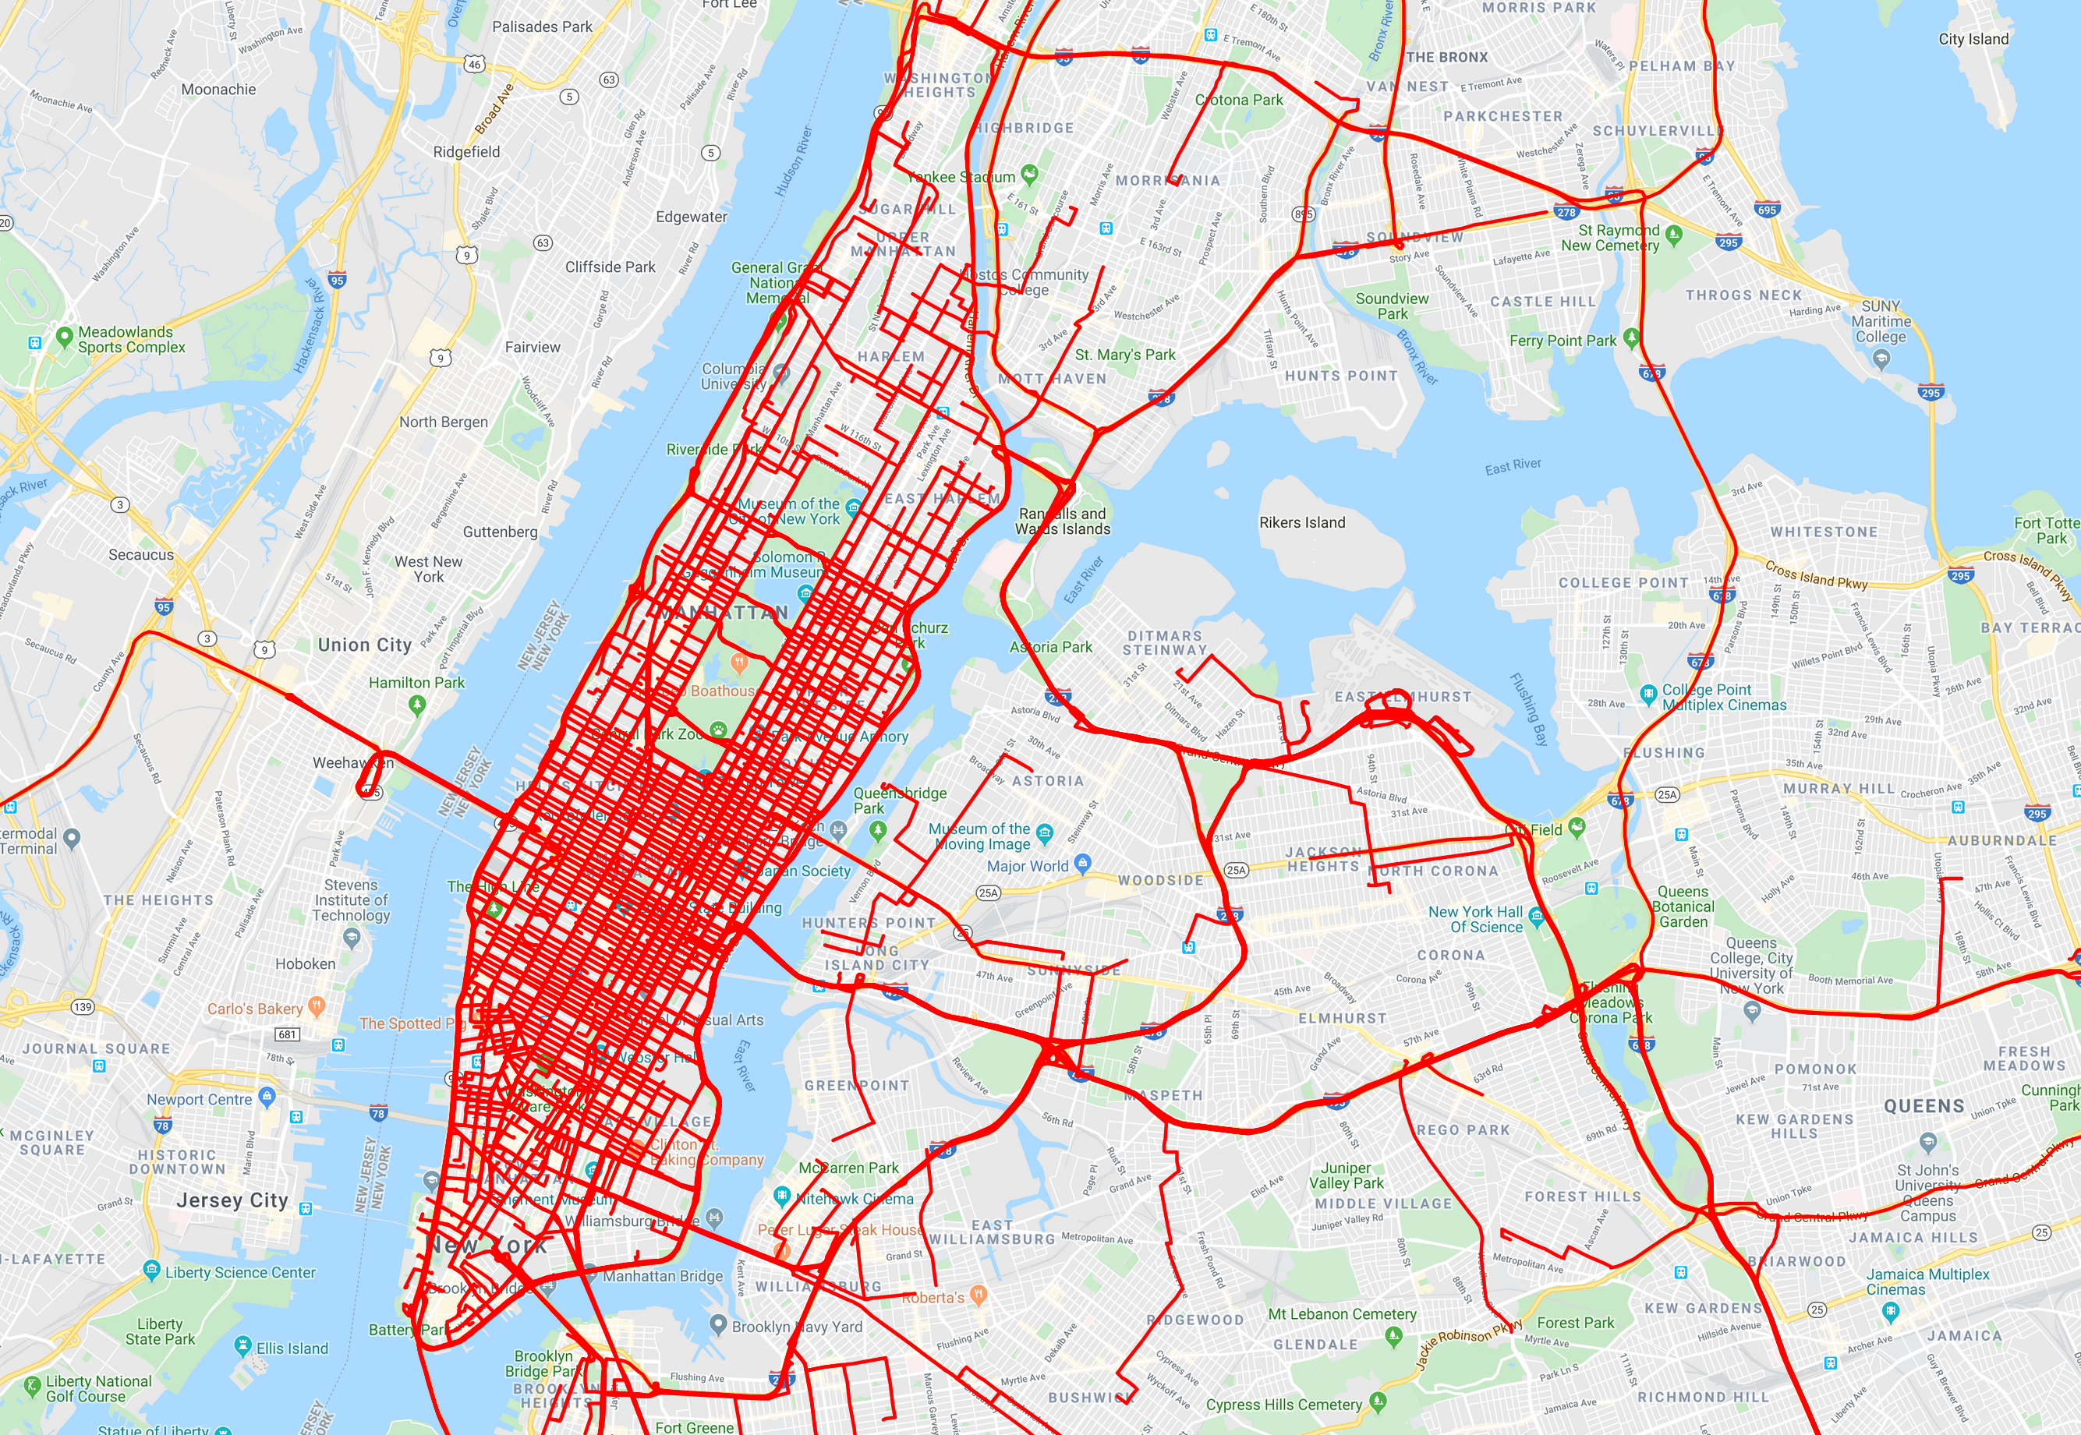
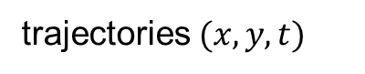
trajectories $(x,y,t)$
(spatiotemporal information of moving objects)
Notes:
Observation area $A$
So now the question is, how can we use these trajectories?

Slide 3
Trajectory Data Mining

Slide 4
discovering patterns in trajectories to inform critical real-world applications
Notes:
Purpose of trajectory data mining is to…

Slide 5
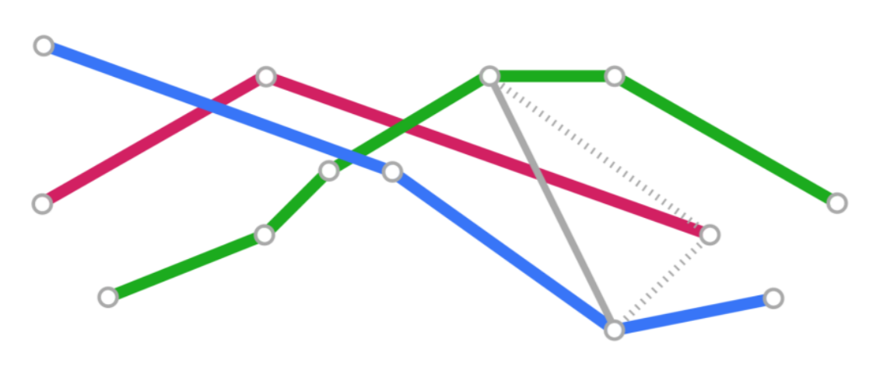
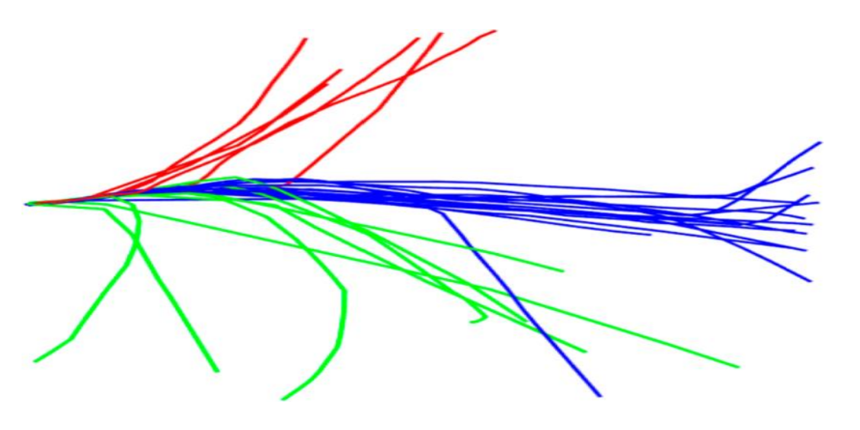
Trajectory Data Mining Tasks
trajectory similarity
trajectory clustering
trajectory anomaly detection
trajectory classification
trajectory prediction
etc…

Slide 6

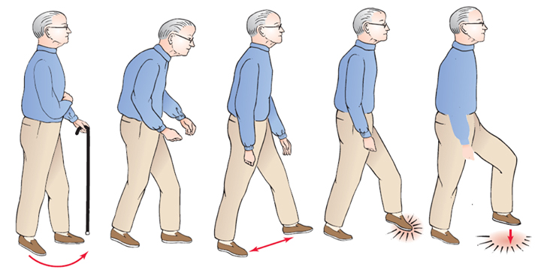
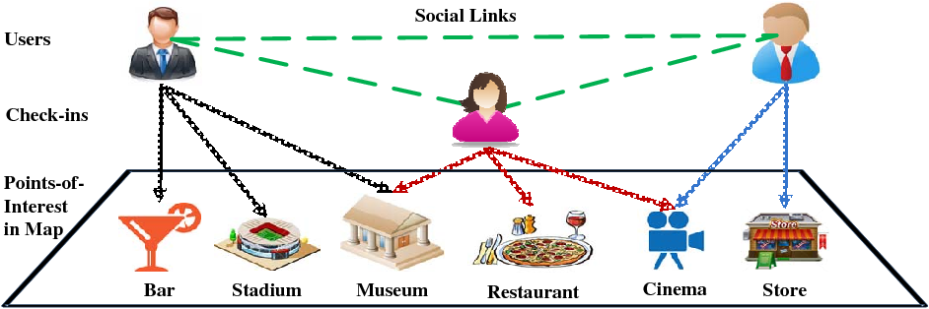
Trajectory Applications
human mobility understanding
healthcare (detecting change in gait pattern of seniors)
location-based services (e.g., recommendation of points-of-interest)

Slide 7
Research Questions

Slide 8
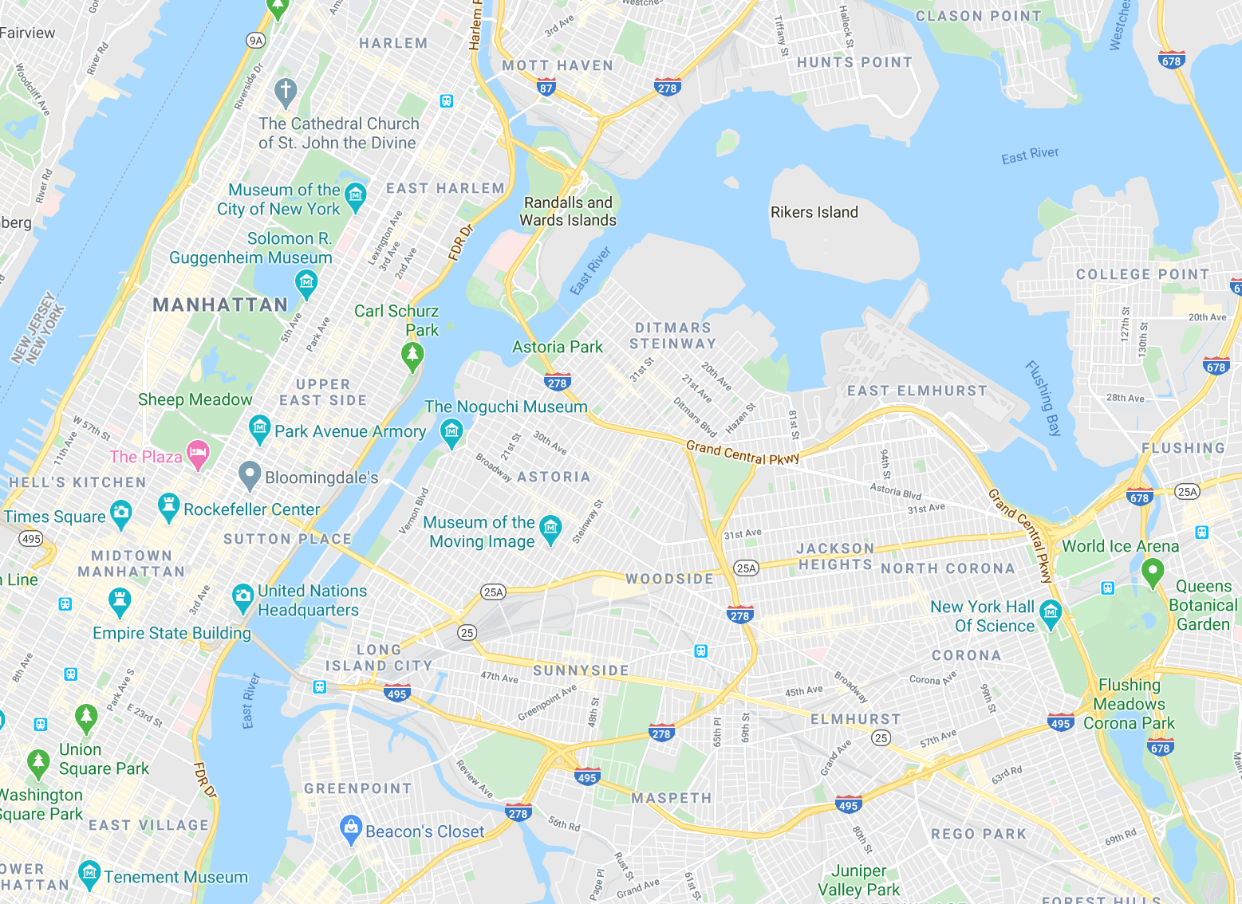
Geographical Proximity
Semantic Proximity
Notes:
Spend more time here!
Geographical: nodes are close to each other in physical space
Semantic: nodes are close to each other based on multiple trajectories passing through both of them.
Next slide discusses that.

Slide 9
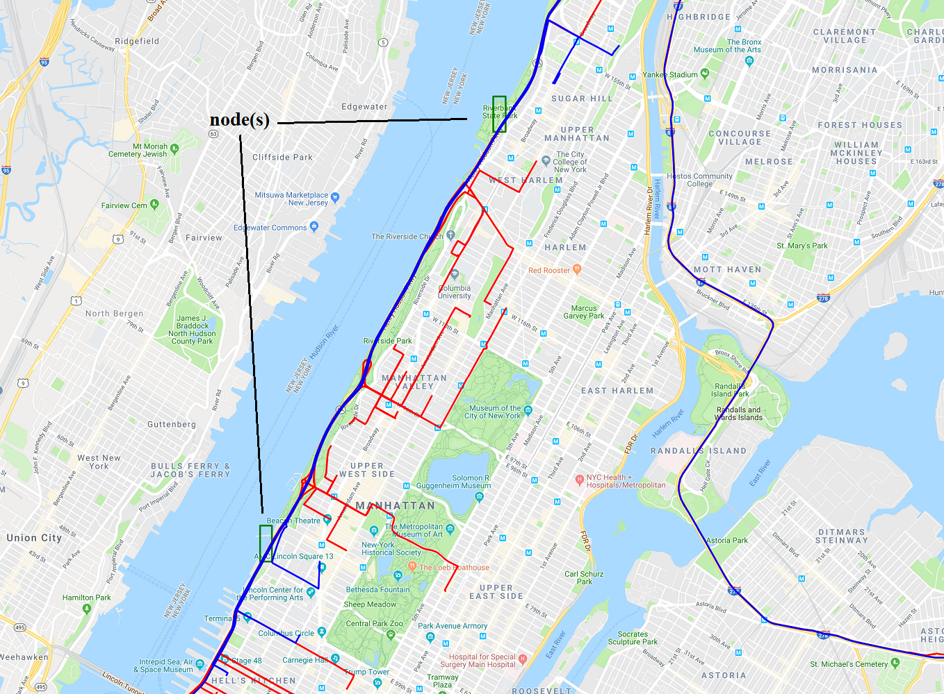
Notes:
Two grid cells (green rectangles) with several trajectories traversing both of them (shown as blue
line), compared to trajectories that traverse either of them (shown as red line).

Slide 10
Research Question I
How people perceive different areas of their city?
Notes:
Is something more related than something else? Yes or No. (Qualitative)

Slide 11
Research Question II
To what extent people rely on geographical proximity of areas?
Notes:
What is the effect of proximity? How much? (Quantitative)

Slide 12
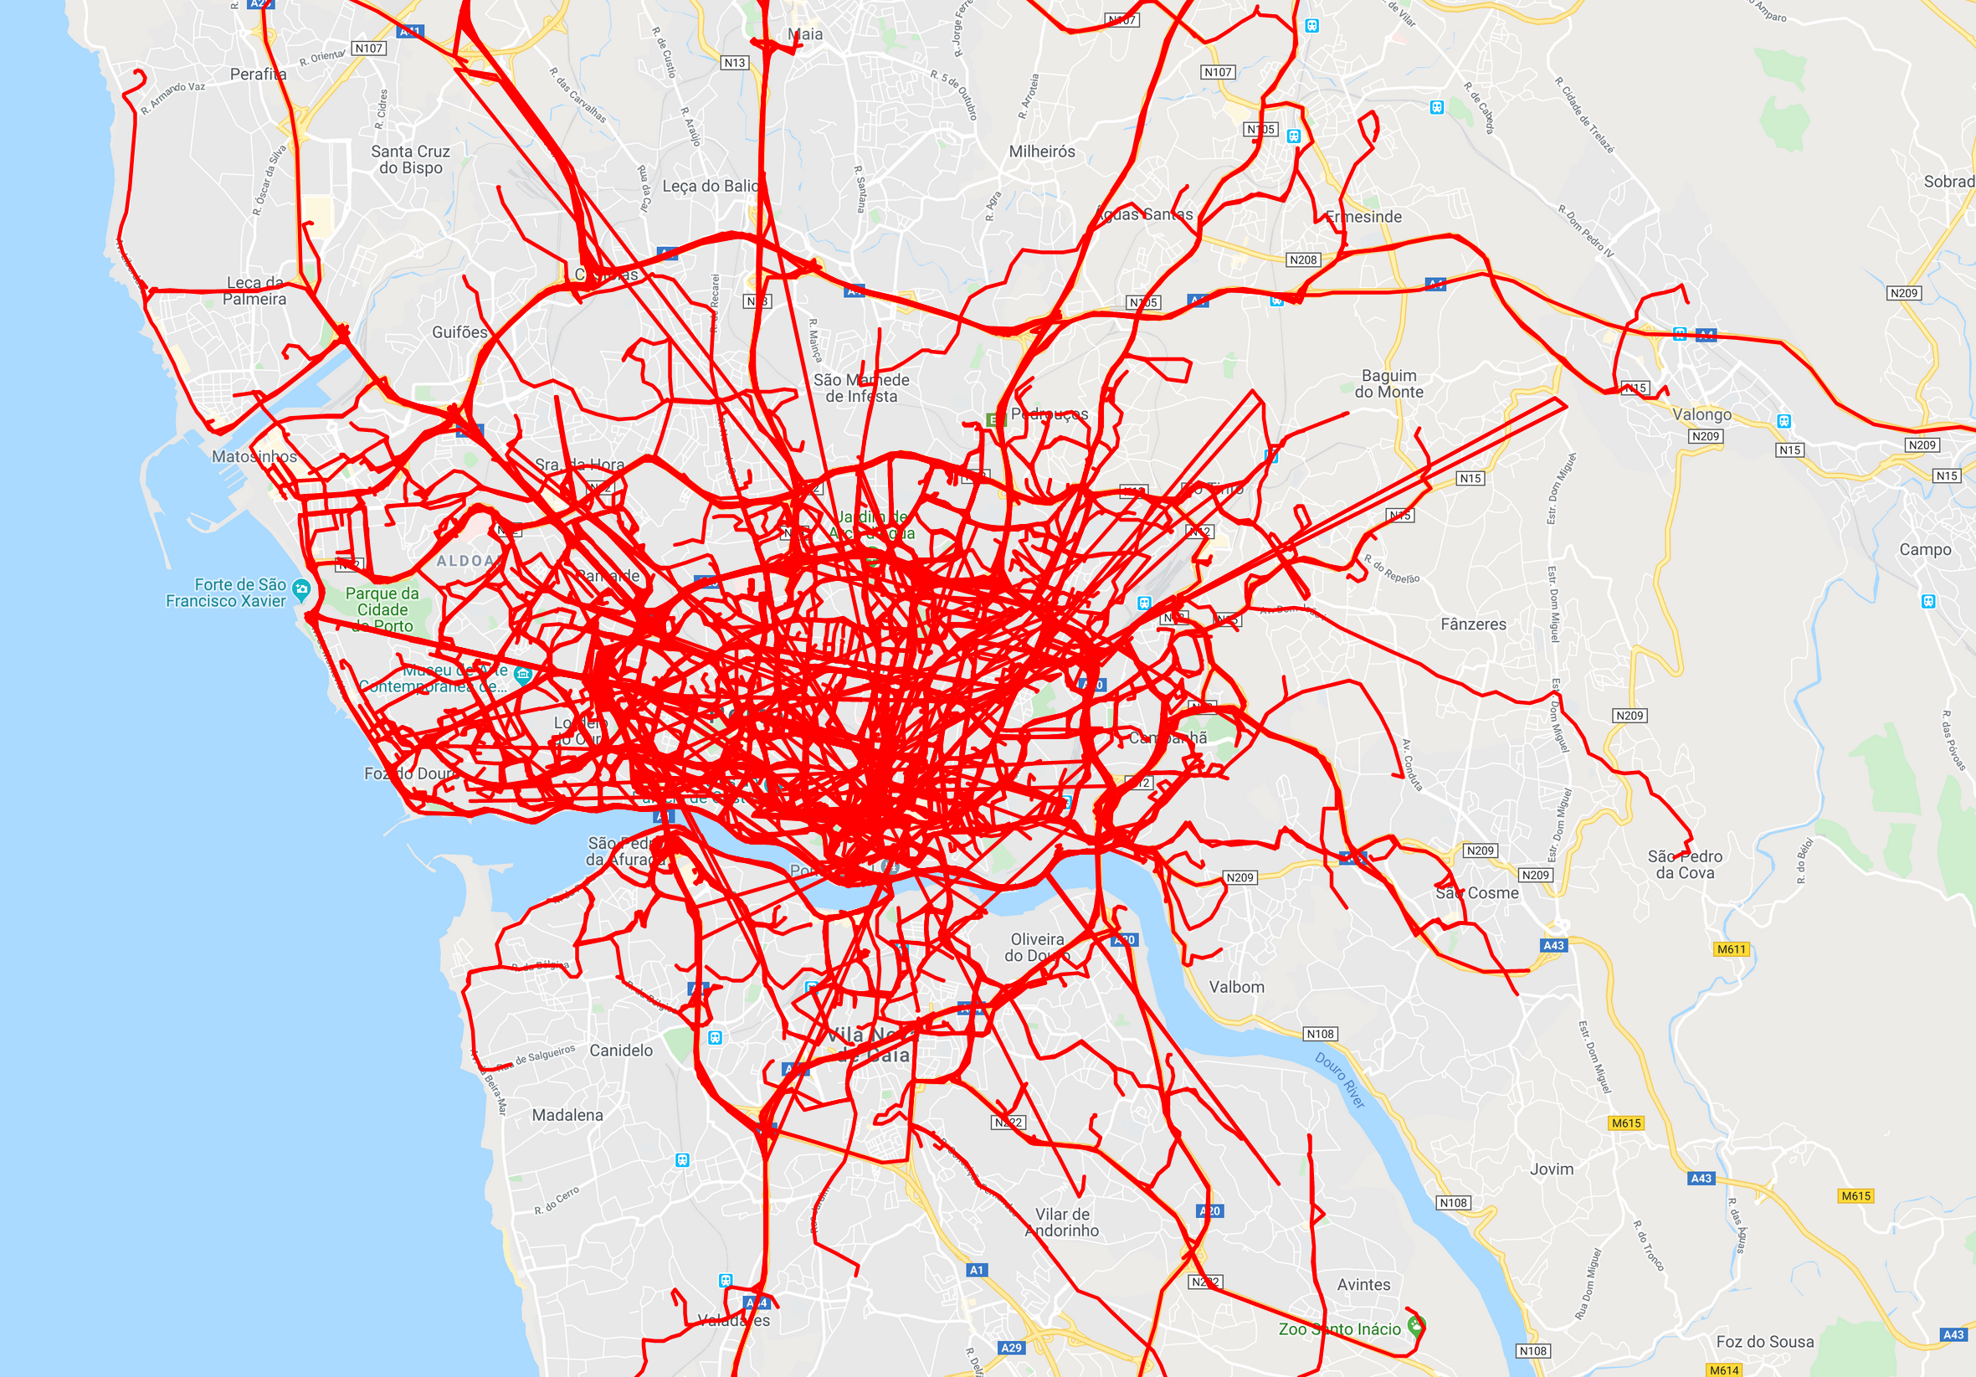
Research Question III
City I
City II
How the behavior of people compare in different geographical space?
Notes:
So now; let us move to our approach towards answering these research questions.

Slide 13
Overview
Method 1
Learning Semantic Relationships of Geographical Areas
Method 2
Statistical Method for Distinguishing Geographical Proximity to Semantic Proximity

Slide 14
Learning Semantic Relationships of Geographical Areas
Notes:
- Method that gives me semantics of a neighborhood.
- Relation between geographical areas based on trajectories

Slide 15
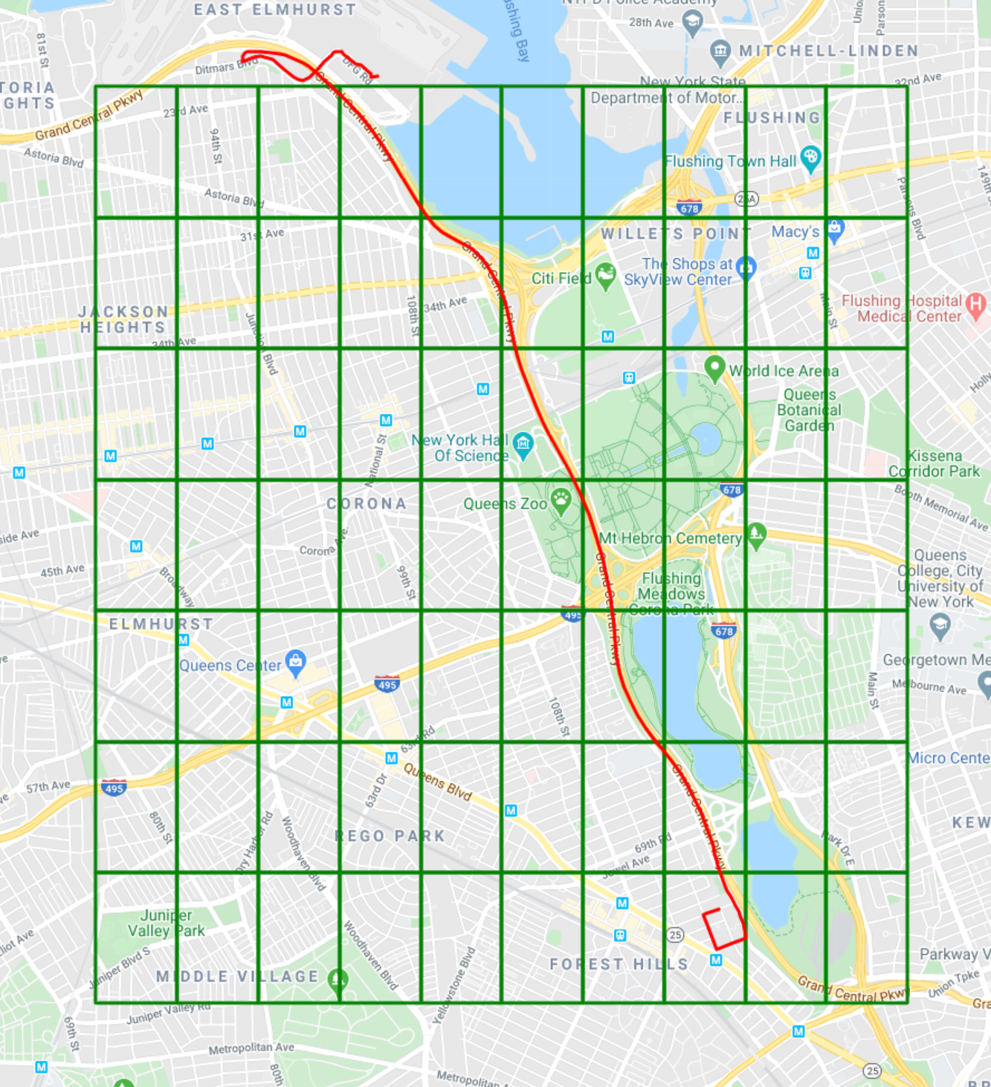
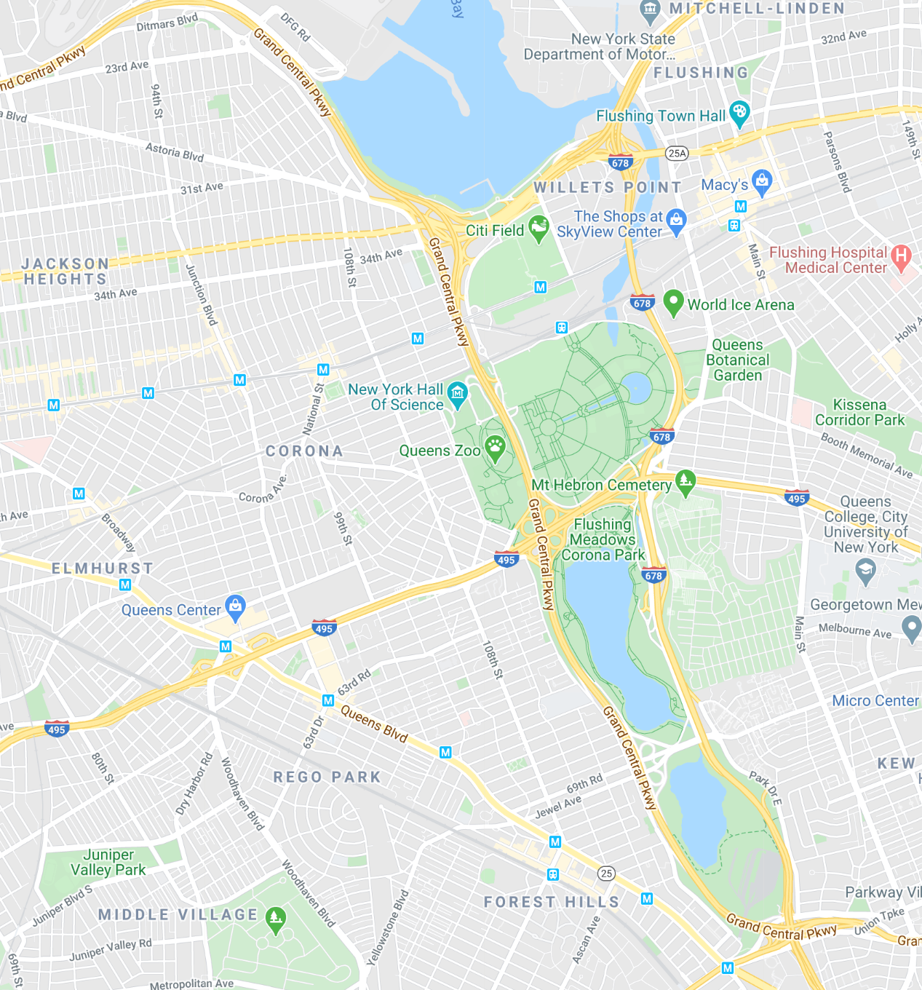
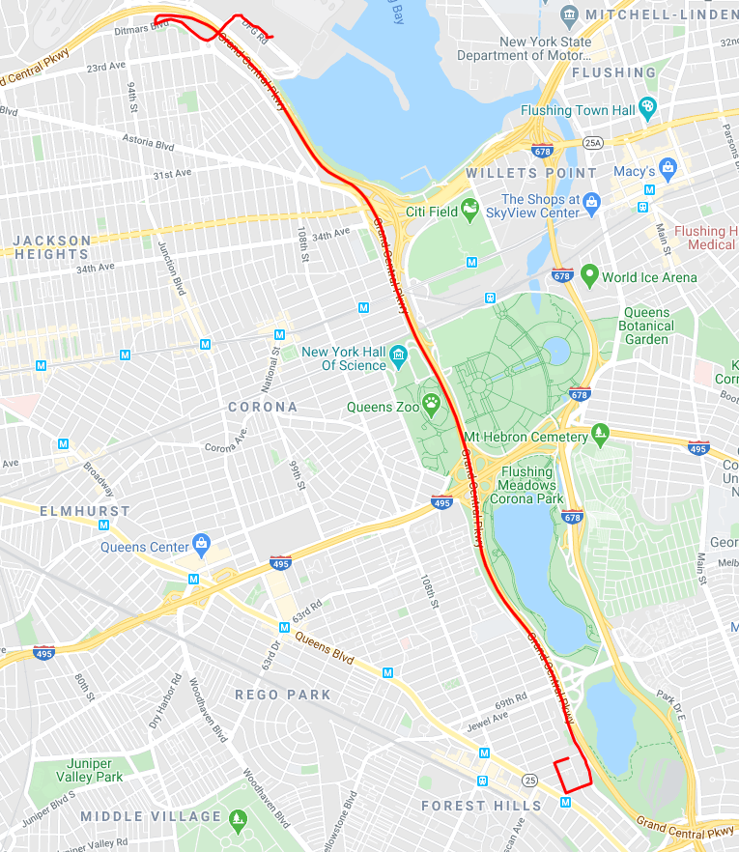
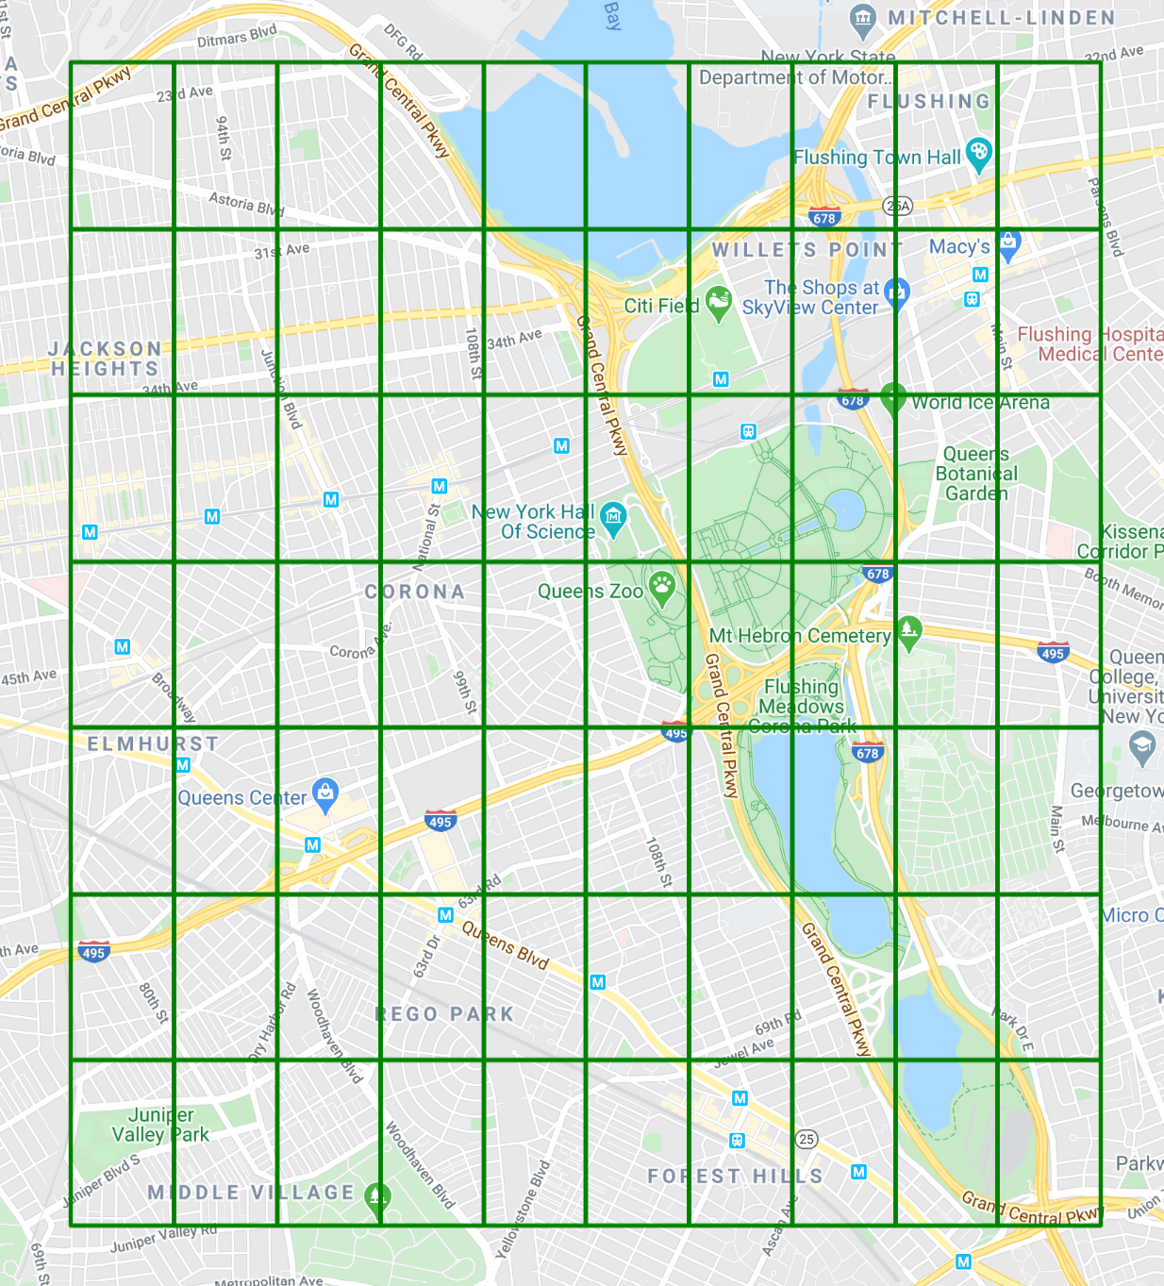
Construction of a Uniform Grid
0
1
2
3
4
5
6
7
8
9
0
1
2
3
4
5
6
7
8
9
0
0
1
1
2
2
3
3
4
4
5
5
6
6
Notes:
Why a grid? Instead of doing direct analysis on trajectories, grid cells make it computationally efficient to relate geographical areas using trajectories.

Slide 16
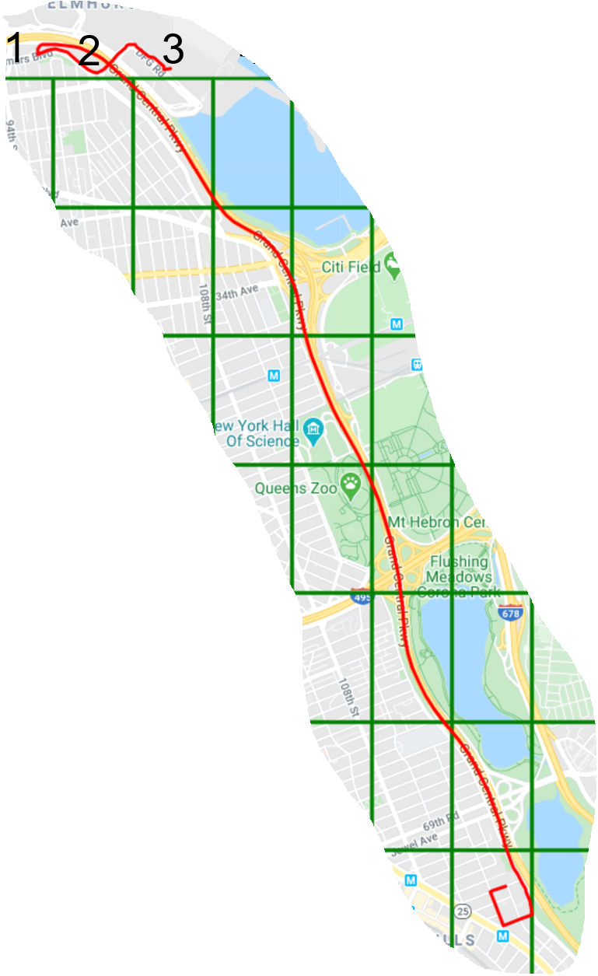



How I Convert Trajectory Into Grid Cells?
trajectory $(x_{i},y_{i},t_{i})$
1
2
3
4
5
6
7
trajectory $(x_{j},y_{j},t_{j})$
8
9
10
11
12
13
trajectory $(x_{k},y_{k},t_{k})$
Notes:
By dividing A into grid cells we can translate trajectory from a sequence of geolocations to a sequence of grid cells.
We convert trajectory into grid cells by performing spatial queries using postgresql and postgis.

Slide 17
How can I find relationships of geographical areas?
learn relationships using
network representation learning (NRL)

Slide 18
Random Walk-based NRL
3
5
3
5
8
8
3 5 8 7 6 4 5
4
6
4
6
1
1
1
1
9
9
2
7
2
7
1 | 3 5 8 7 6 4 5
2 | 1 3 5 8 7 6 5
. . . . | . . . .
87 | 8 5 4 3 5 6 7
88 | 4 5 6 7 8 9
89 | 2 1 3 5 6 7 8
90 | 7 4 2 1 3 5 6
Input graph
Obtain a set of
random walks
2
1
4
3
5
8
6
Treat the set of random walks as sentences
9
7
vector embedding
for each node
Feed sentences to
Skip-gram NN model

Slide 19
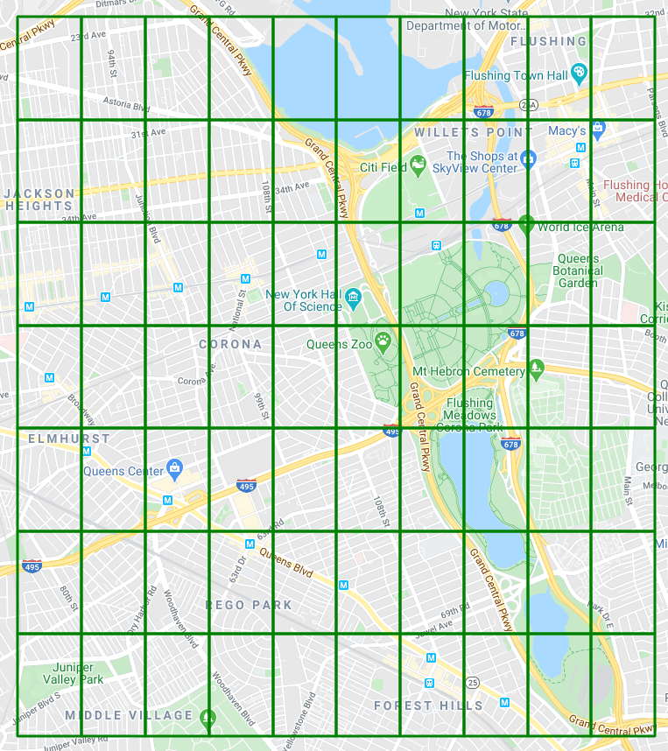
Construction of a lattice graph
0
1
edge
0
0
edge
Grid Cells
1
0
lattice graph
Notes:
Put different grid sizes.

Slide 20
Trajectory as walks
lattice graph
walks as grid cells

Slide 21
Trajectory Permutations: skip-gram
nodes appearing in same context window are more similar
for trajectories, every node should be in the context of every other node
Skip-gram (context window)
shuffling
m-walks
m-times
single walk
feed walks to skip-gram NN model
Notes:
- skip-gram: more semantically similar two nodes are, the more they will tend to occur in similar contexts.
- By design skip-gram architecture weighs nearby context nodes more heavily than distant nodes.
- Shuffling will neutralize the effect of context nodes and distant nodes will not be less weighted than nearby nodes.

Slide 22
Statistical Method for Distinguishing Geographical Proximity to Semantic Proximity
Notes:
Up till now, we discussed how to learn semantic relationships between geographical areas.
This section discuss statistical models including a null model based on null hypothesis (i.e., people perceive a city based on geographical proximity) which means chance to move from one place to another is dictated by physical separation (we will disprove this null hypothesis)

Slide 23
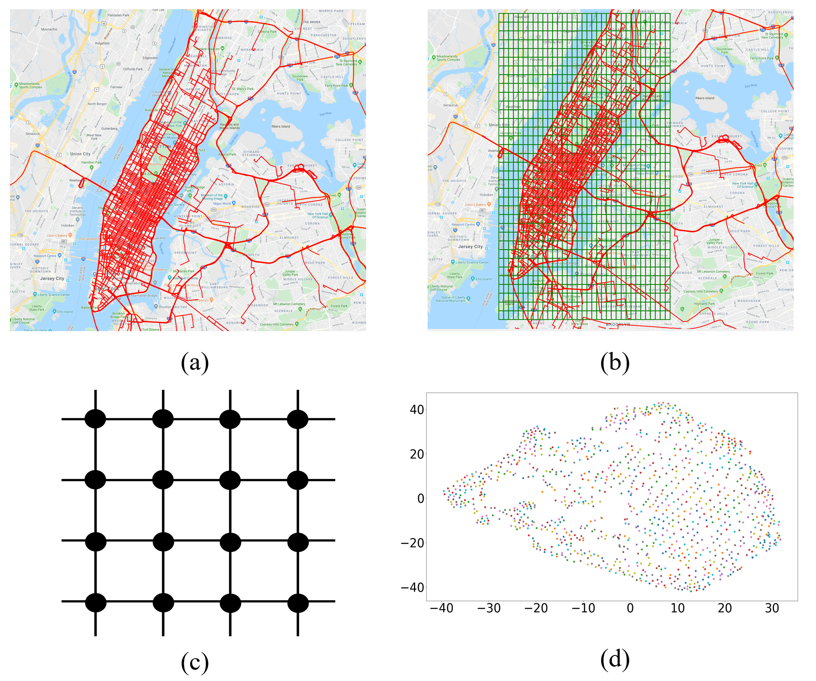
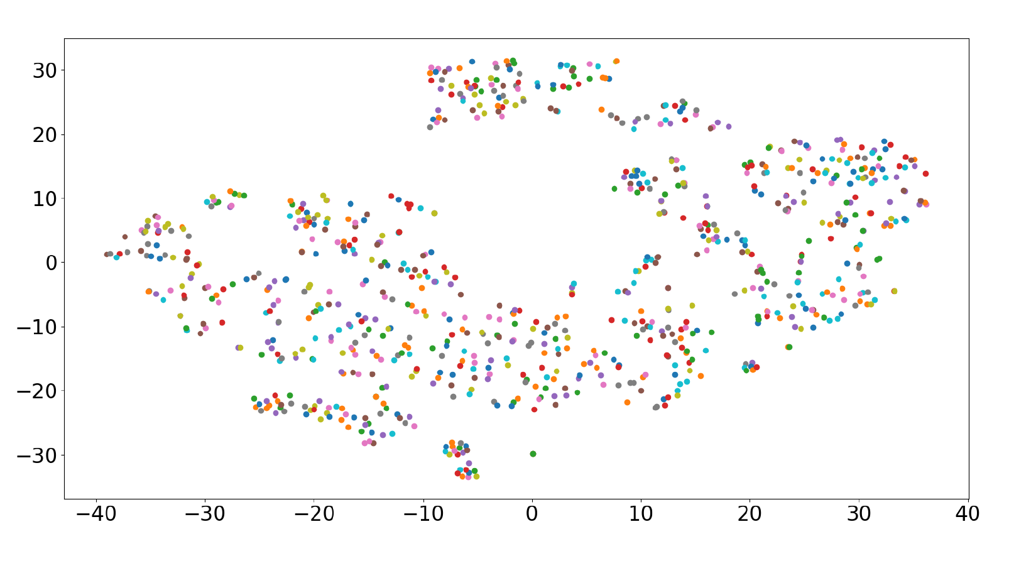
Real Model
Real model is based on real trajectory movements over lattice graph
method 1

Slide 24
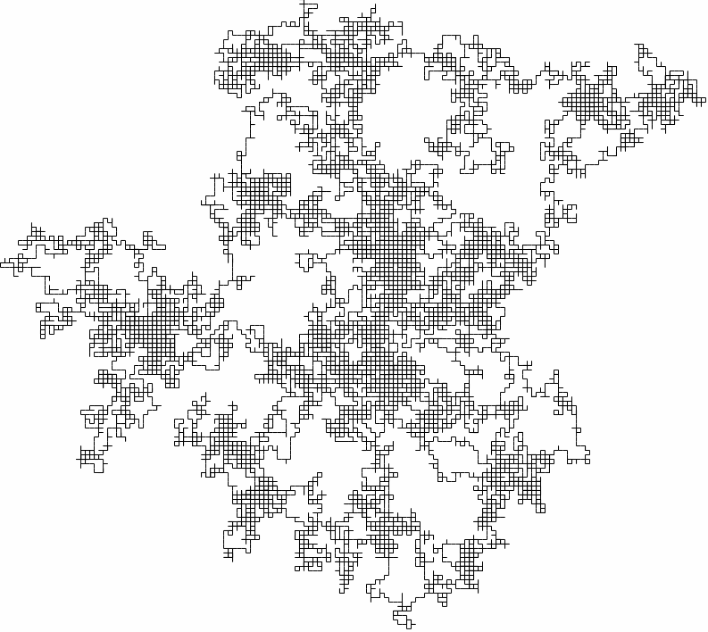
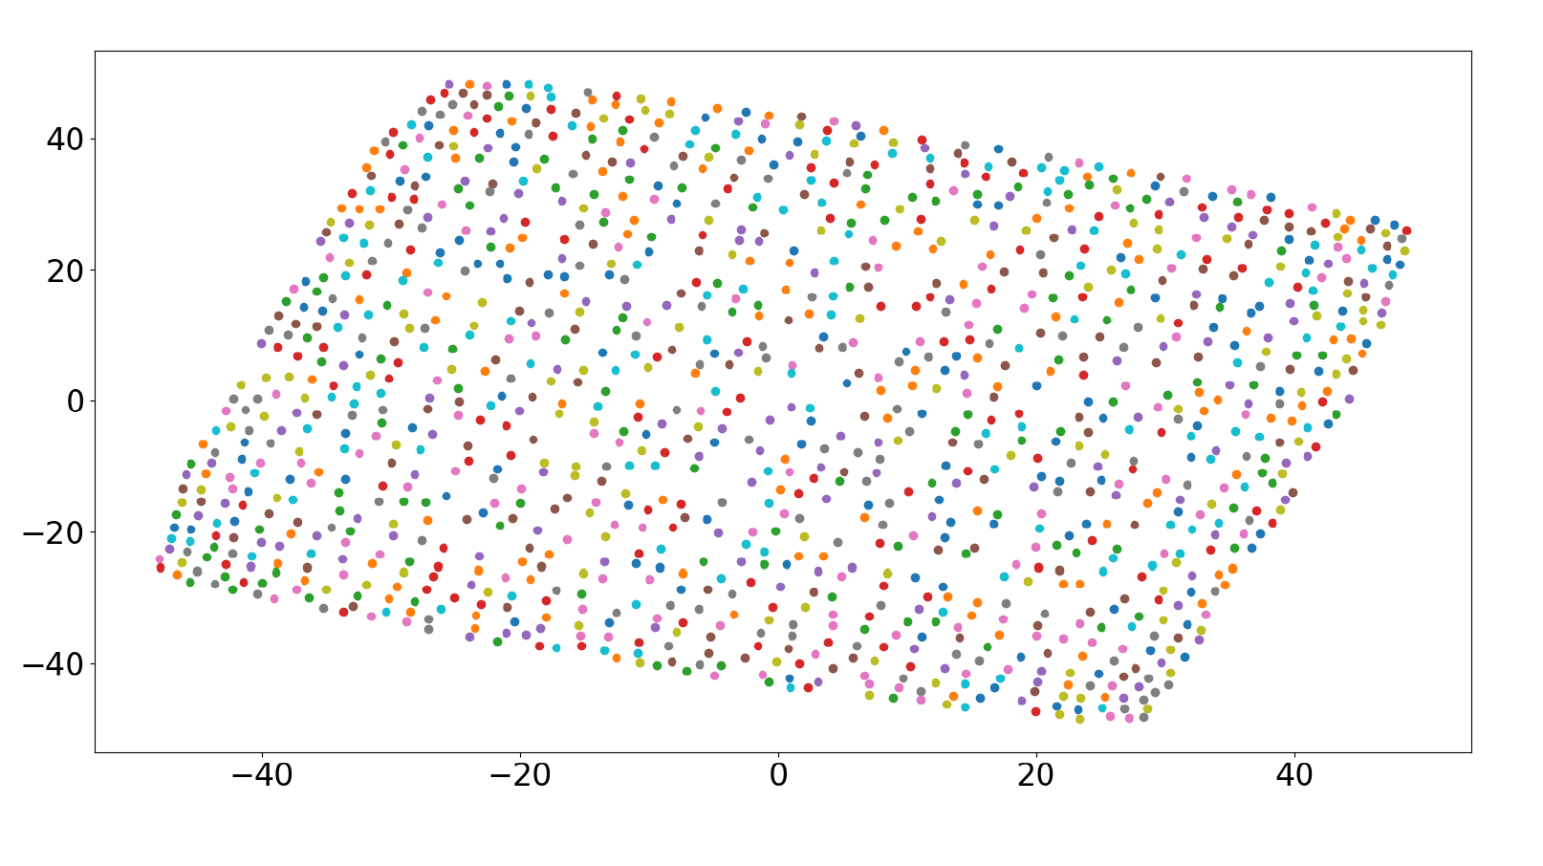
Null Model
Null Model is based on random walks but satisfies the size constraint
method 1
Notes:
- Same number of random trajectories as before. (we get trajectories by performing random walks)
- Size of each random walk is equal to the average of all real trajectories (very important)

Slide 25
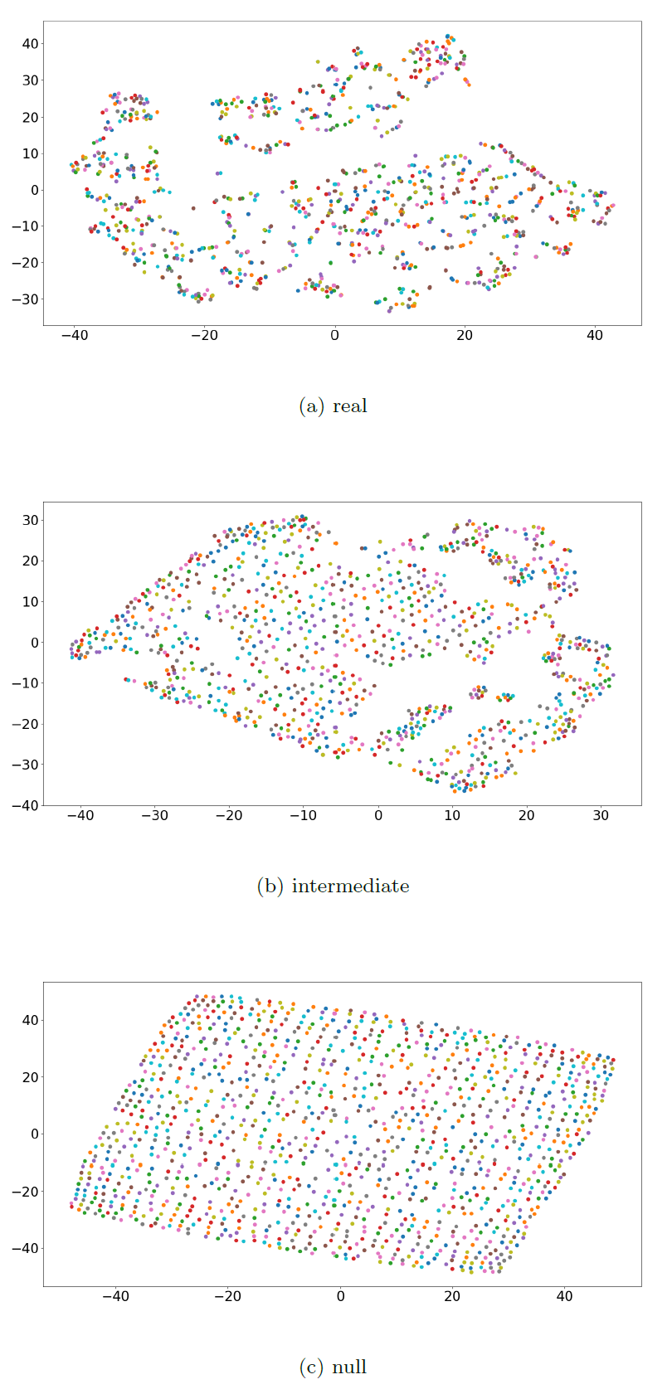

Alternate Null (Intermediate) Model
Intermediate model is like Null model but satisfies the constraint for each walk starting from the same node $u$ as Real model walks
method 1
Notes:
main motivation for this model is to learn vectors that can capture more of the constraints of the real trajectories, but still maintain the unbiased random walks on the lattice graph that are still dictated by geographic proximity

Slide 26
Model Comparative Analysis
how can we compare the
real vs the null model?
metrics for both quantitative and visual comparison
Notes:
Quantitative: Cosine similarity and difference, distribution of pair-wise similarity (histogram)
Visual: embeddings
- The aforementioned models learn a low-dimensional vector representation for each graph node
- Further I discuss metrics that allow to compare models quantitatively and visually

Slide 27
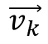
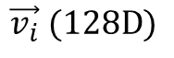
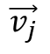
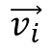
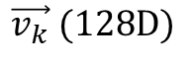
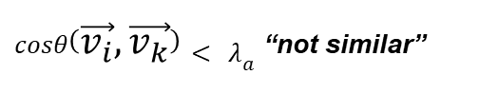
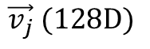
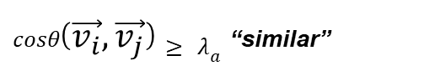
Quantitative: Cosine Similarity
$$\vec{v_{i}} (128D)$$
$$\vec{v_{j}} (128D)$$
$$\vec{v_{k}} (128D)$$
$$\vec{v_{k}}$$
$$\vec{v_{i}}$$
$$\vec{v_{j}}$$
$cosθ\left(\vec{v_{i}},\vec{v_{j}}\right)≥ λ_{a}$ _{“similar”}
$cosθ\left(\vec{v_{i}},\vec{v_{k}}\right)< λ_{a}$ _{“not similar”}
Notes:
Cosine similarity between vectors (nodes) is used to figure out pairs of nodes that are semantically similar

Slide 28
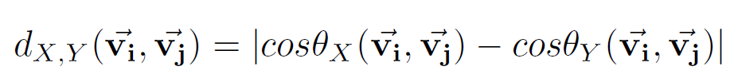
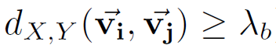
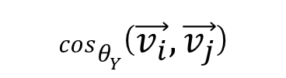
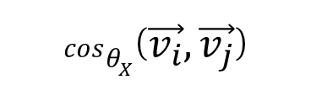
Quantitative: Interesting Pairs of Nodes
Let’s say we have two models $(X and Y)$
$$cosθ_{X}\left(\vec{v_{i}},\vec{v_{j}}\right)$$
$$cosθ_{Y}\left(\vec{v_{i}},\vec{v_{j}}\right)$$
_{“interesting”}
Notes:
Difference between cosine similarities of different models is used to find the most interesting pairs of nodes.
- pair of nodes are interesting when their associated vectors are found to be very similar in one model and dissimilar in the other.

Slide 29
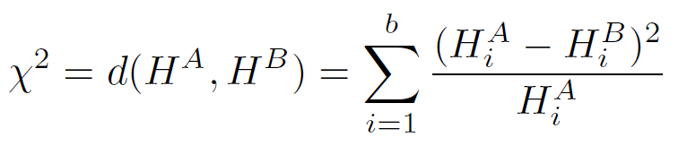
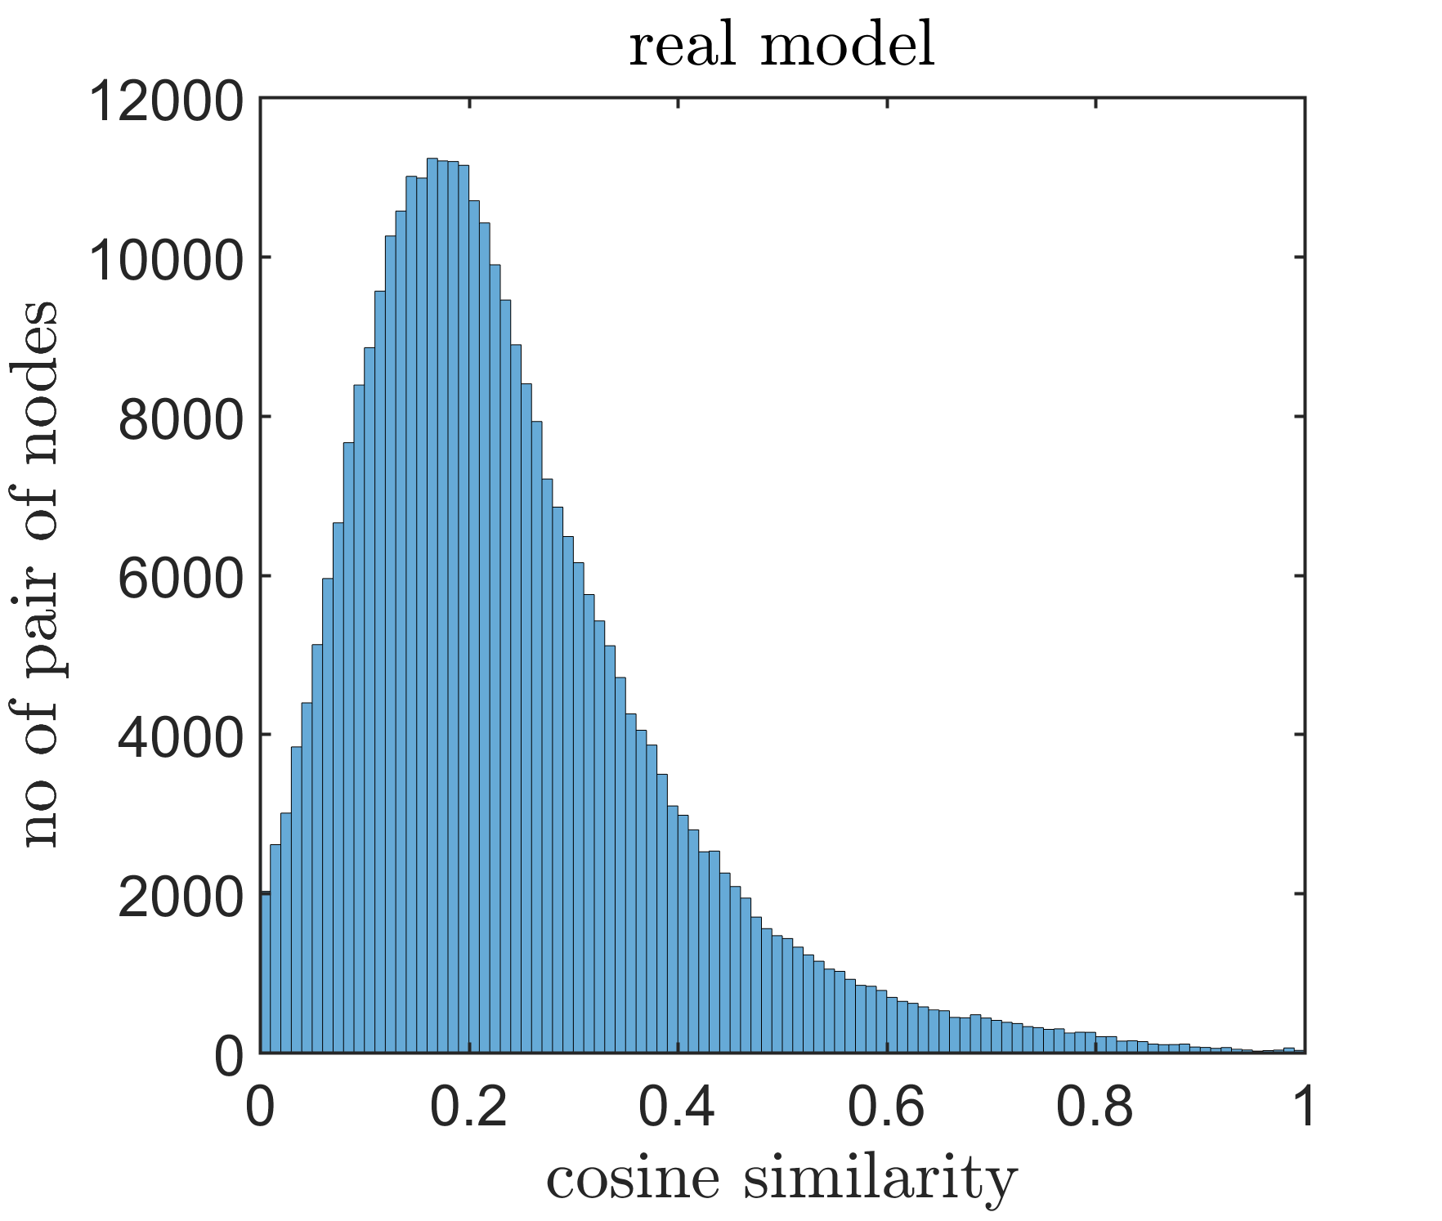
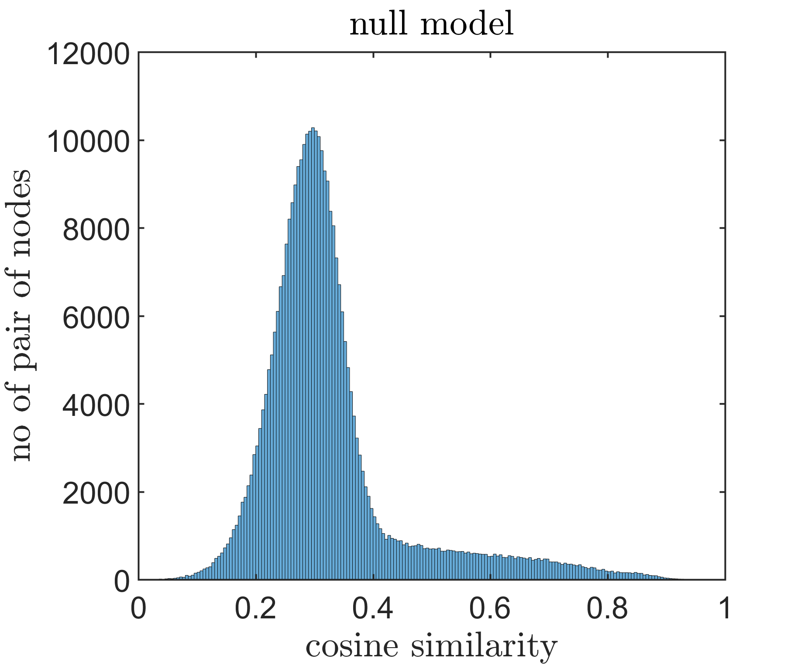

Comparing Distributions of Models
Let’s say we have two Histograms $(H^{A} and H^{B})$
Where $b$ is the number of bins
Notes:
To compare two models we rely on comparing the distance (chi-square) between two histograms.

Slide 30
Exploratory Analysis of Models
A many-to-many visualization
Notes:
- that can provide summary of how embedded vectors are organized in low-dimensional space

Slide 31
Research Question III
New York
City of Porto
How the behavior of people compare in different geographical space?

Slide 32


Chi-Square
City of New York
real distance from null: $χ^{2}=4.0854e+05≫0$
real distance from intermediate: $χ^{2}=3.0426e+05≫0$
City of Porto
real distance from null: $χ^{2}=6.1697e+05≫0$
real distance from intermediate: $χ^{2}=7.8492e+05≫0$
Notes:
- when using the Chi-Square, the closer to zero is the result, higher is the similarity between the histograms.
- Both in the case of NYC and City of Porto the real model is significantly different than both null and intermediate model, which means that the null hypothesis (that people in a city move randomly) can be rejected

Slide 33
Summary

Slide 34
Summary
performed statistical analysis to distinguish geographical to semantic proximity
Notes:
Trajectories can be used to understand latent semantic relationships between geographical areas and comprehend user perception regarding geographical space

Slide 35
Thank you!

